Slide 1

Investor Presentation
Strictly Private & Confidential

Slide 2
Company Overview

Slide 3
Marksans Pharma Limited (MPL)
Marksans straddles across key therapy areas and markets its products in both evolving and developed markets
Core competencies: Formulations manufacturing and marketing
Marksans is focusing on drugs going off patent between 2013 and 2018
World Class Manufacturing Facilities -Approved by USFDA, UKMHRA Aus TGA and Brazilian ANVISA
CRAMS Services Utilizing Low Cost Manufacturing Base to Market Leaders of Pharma Industry
Own Front Ends into UK/Europe and Australia
* Filed 27 ANDAs
* 150 Approved Dossiers for Europe, Australia & Canada
Rapidly Expanding Business Operations in the US, UK, ANZ, Europe and Canada
More than 500 Approved Dossiers for South East Asia, Russia, Ukraine, Middle East & West Africa

Slide 4
Historical Profit and Loss Account
4

Slide 5
Historical Balance Sheet
5

Slide 6
Shareholding Pattern

Slide 7
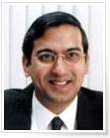
The Promoters
The Company was established by Mr. Mark Saldanha, a first generation entrepreneur, with the vision to develop a global pharmaceutical company.
MPL is rapidly progressing and expanding under his dynamic leadership.
Mr. Saldanha has more than two decades of experience in production, marketing and finance functions of the company, and is well versed with overall management of the company.
Before promoting this venture, Mr. Mark Saldanha held the position of whole time Director at Glenmark Pharmaceuticals Ltd.
Mark Saldanha
Managing Director & CEO
The Promoter is currently engaged in the Pharmaceutical business only

Slide 8
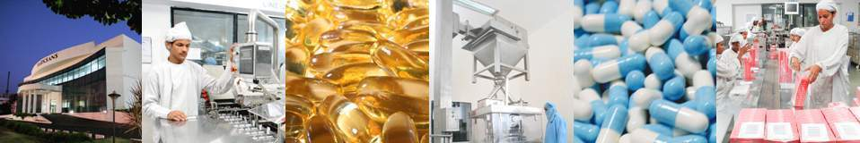





State-of-the-Art Manufacturing Facilities
Marksans Goa Manufacturing Facility – one of the largest in Asia for soft gelatin capsules and tablets
Multi-purpose UK MHRA licenced facility at Southport UK
Accredited & Approved by
Accredited by

Slide 9
Manufacturing Facilities–Goa
International Standards adhering to Stringent Quality Norms
World Class Manufacturing Capabilities catering to Formulations
Key Features:
  18,000 sq. ft with Scalable Capacity
  100% EOU
  USFDA , UK MHRA, Australian TGA approved
  One of the Largest Manufacturing Facility in Asia for soft gelatin capsules and tablets
  Fully Automated Packing Operations
  R&D centre with three divisions :DSIR approved
    Formulation Development
    Devising Analytical Methods
    Conducting Stability Studies

Slide 10
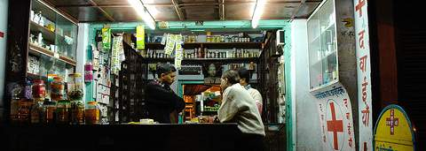
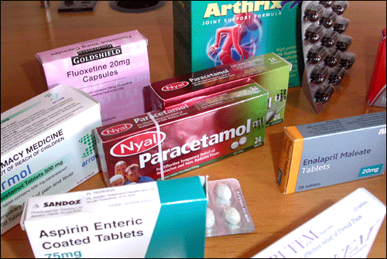
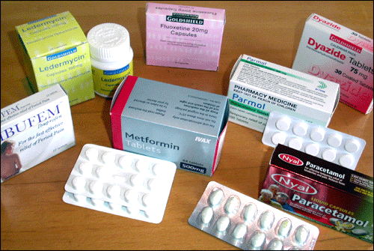
Product Portfolio

Slide 11
Strengths
Global Presence
World-Class Manufacturing Facilities with Scalable Capacities
Tie Ups with Market Leaders
Preferred Outsourcing Partner
Low Cost Manufacturing Base
Strong R&D, Dossier Development Capabilities
Wider Product Basket (OTC to Rx)
CRAMS for US/Global Markets
US FDA, UK MHRA, Australian TGA & Brazilian ANVISA Approved
Own Front Ends into UK/Europe & Australia
125+ Product IPs in Regulated Markets )
500+ Product IPs in Semi-Regulated Markets

Slide 12
Strategy & Growth Initiatives

Slide 13

Growth Strategy
MARKSANS PHARMA GROWTH STRATEGIES
ORGANIC
GROWTH STRATEGY
IN-ORGANIC
GROWTH STRATEGY

Slide 14
ORGANIC GROWTH STRATEGIES
Market Share
Growth
Market Leveraged
Growth
Customer Leveraged Growth
Strengthen and expand current core businesses
( Formulations)
Product expansion, channel expansion and sales effectiveness
Increasing ANDAs pipeline by increasing R&D Capabilities
Expand offshore market penetration
Out-licensing opportunities
New geographies, new customers, new channels
New opportunity evaluation and development
Creating options for future businesses
New Products, new services
R&D focussed and customer centric initiatives
LOW
HIGH
BUSINESS RISKS AND TIME INVOLVED

Slide 15
INORGANIC GROWTH STRATEGIES
Acquisitions
Strategic Alliance
Initiatives already taken in this direction
(Relonchem, UK; Bell Healthcare, UK & Nova Pharmaceuticals, Australia)
Instantly added new brands, products and state-of-the-art manufacturing facilities
Fresh customer base, addition of new geographical locations
Economies of scale and integration to operations
Fresh breath of management skills and talent acquired
Time-to-market substantially reduced, giving a significant competitive edge
Out-licensing ANDAs to increase market penetration
Combined competitive energies into building competitive advantage & defeating mutual rivals
Leveraging manufacturing and R&D
competencies in India
Using global front-ends for Marketing
Leveraging the India Advantage (Low-cost for manufacturing and R&D)

Slide 16
Key Growth Drivers
Rapid filing of ANDAs into the US, Europe & emerging markets.
Expand Contract Research and Manufacturing Services (CRAMS) in the Regulated Markets.
Acquisitions of growing, profitable pharmaceutical companies and/or products.
The company has entered into a share purchase agreement with UK's Hale Group to acquire its entire share capital, along with its subsidiary companies:
  Bell Sons & Co (Druggists) Ltd.
  Relonchem Ltd.
  Nova Pharmaceuticals Australasia Pty. Ltd.
Enter into out-licensing arrangements with Pharma market leaders in the US and Europe to manufacture and market post-patent & off-patent drugs.

Slide 17
US Market – Post Patent Product Launch Strategy
Technology Driven Niche Liquid Gel Market
This market is tapped by select players, thus providing differentiation in crowded generic market
Innovator Product
  First to file the product in the US
  Aiming for Day 1 launch after patent expiry in the US
  Tie up with one of the largest pharma companies in the US
  Exclusive supply & marketing arrangement
  Backed by upfront licensing fees and milestone payments

Slide 18
Strategies for Targeting the Big Apple
Target products coming off patent between 2013 and 2018
Tie ups with multinationals, generic companies and distributors for the distribution of our products in the US
Remain focused on the development of high-end Rx products for launch in the US
Commercialize through our own front end and through distribution arrangements with our partners
Aiming at out-licensing ANDAs to leading Pharma companies.

Slide 19
Emerging Markets – Current Status and Strategies
Continue registration of products across geographies, with a focus on markets with high potential
Emerging markets - one of the major drivers and revenue earners for the company
Initiated launch of our own brand registration in emerging markets of Africa, Russia, CIS, Sri Lanka and South East Asia
Product basket covering wide therapeutic changes: - Liquids, Solid Orals.

Slide 20
Subsidiaries

Slide 21
Marksans Pharma UK Ltd

Slide 22
Introduction
Marksans Pharma UK Ltd. (“MPL UK”) is the UK-based wholly-owned subsidiary of Marksans Pharma Ltd.
Registered Office: Widnes, London
Mergers & Acquisitions:
  Acquired UK-based pharma company, Hale Group, the parent company of Bell, Sons and Co (Druggists) in January 2008
  Acquired UK’s leading generic drug marketing and distribution company, Relonchem in August 2008.

Slide 23
Bell, Sons and Co (Druggists) Ltd.

Slide 24
Introduction
Bell is a well-established manufacturer of a broad range of OTC pharmaceuticals, approved by the UK MHRA
Human Resources: 106 people at the freehold licenced manufacturing site at Southport, Merseyside and 12 employees for sales administration, buying and technical support
Bell’s licenced products contribute over 45% of total turnover – currently holds 38 product licences currently registered with MHRA
Bell Products
Licenced Products
Own Branded Products
Own Label Products for Retailers, Pharmacies, Wholesalers, Cash & Carry Outlets
Unlicenced Products

Slide 25
Products
The own label market now accounts for more than 45% of the Company’s total turnover
Comprehensive UK customer base with excellent distribution between retail and wholesale sectors
Significant and well-established portfolio of export distributors
Product Basket
Cough & Cold Remedies
Galenicals
Vitamins
Palliative & Healthcare
Oils
Antiseptics & Disinfectants

Slide 26
Export Trade
Over 80 years of experience in the export market - a network of established distributors for overseas markets
The Company’s brand well-recognised and respected in overseas markets
Ensuring stability in terms of marketing & price maintenance by providing exclusive distribution rights to distributors, in the country of operation
Widespread reach in 50+ countries, with principal markets in West Africa and the Middle East
Export customers provide 1/3rd of the Company’s total sales revenue. The top 10 customers account for 60% of total export turnover and 20% of total Company turnover

Slide 27
Business Operations
Supplier and manufacturing process
  Supplier Approval: Key suppliers are audited covering quality and control procedures
  Raw materials and packaging components are purchased only from approved suppliers
Distribution
  Order carried out by company employees
  Distribution outsourced to select transport companies
  Advantages of outsourcing delivery: High degree of flexibility w.r.t size of order and improved level of service
Raw Materials & Packaging from Approved Suppliers
Quality Control Inspection
Chemical Analysis for Key Elements
Released for Manufacturing & Production

Slide 28
…Business Operations
Product development
  Product development undertaken by dedicated laboratory technicians in Widnes, Cheshire
  16 products at various stages of development;
  Research undertaken includes:
    Developing products that complement its product range
    Formulations for similar goods already in the market
  It is currently estimated that a new product takes 2 years, from the commencement of development to approval by the MHRA
  We are adding basket of solid oral dosage form products & soft gels apart from existing liquids & ointments products under Bells.

Slide 29
Key Attractions
Well established with Excellent Reputation in the UK and the Export Markets
Strong Presence in the Own-label Product Market (40% of turnover)
Potential to Introduce New Product Lines
Over 30% of Sales to Export Markets
Consistently Profitable with Good Prospects for Growth
38 Product Licences
Highly Qualified Product Development Team
Fully Approved by MHRA
Proficient and Experienced Second Tier Management and Loyal Staff
Freehold Premises with Room for Expansion

Slide 30
Upsides Envisaged
The acquisition will provide Marksans an entry into the branded product category in Europe as Bell has a vast distribution network
Liquid formulations exports from India is poor. Bell manufacturing facilities can be used for the production of liquid dosages to supply Marksans’s current markets
Synergies and cost savings can be achieved by outsourcing MHRA-approved Bell solid dosages manufacturing to Marksans formulation facilities
Assistance from Marksans in sourcing raw materials from India
Product sales across geographies
  Sale of Bell products through Nova (Australia) and vice versa

Slide 31
Relonchem Ltd.

Slide 32
Introduction
Set up in 2002 for licensing, marketing and supply of generic pharmaceutical products in the UK market
Product manufacturing done in India, ensuring a low cost of goods and a competitive position in the market
Distribution Partners: Major national distributors like AAH, Unichem and Phoenix,Lyods,Boots Almus and regional wholesalers, NHS
Primary Focus: Licensing, marketing and supply of generic pharmaceutical products to wholesalers, retailers and hospitals in the UK.
Plans for out-licensing and providing distribution agreements to generic companies worldwide
Products encompass most of the therapeutic classes

Slide 33
Product Registrations

Slide 34
…Product Registrations

Slide 35
Business Operations
Sales and distribution
  Sales and distribution is managed from Southport
  Price structure is continually reviewed based on market intelligence
  Excellent relationships with national distributors like AHH and Unichem.
  Balance sold through regional wholesalers like Sigma and Boots etc, with well-established networks into the retail sector
  Products also supplied to global generic players like Actavis
Pricing Strategy
  Sale price of generic products predominantly dictated by the market
  Market trends determined through Constant communication with customers
  Three way agreements with the API vendor and contract manufacturers to ensure a constant presence in the market and to react quickly to upturns in product pricing
  For Own Label Supply (OLS), the company provides the finished product in customers’ own livery and based on the market risk, price is determined

Slide 36
Key Attractions
Marketing and Distribution:
  Strong sales and marketing expertise
  Supplier to major national distributors, regional distributors and global generic players in the UK
Technical and Regulatory Expertise:
Highly reputable track record for attaining MHRA approval for the manufacturing facilities, complex technical transfers and registration of new developments in Europe
Commercial Experience:
  Management of lifecycle of molecule
  Ability to replicate market share successes and expansion into Europe

Slide 37
…Key Attractions
People Resources:
Excellent team, fully integrated with the Indian pharmaceutical market, optimising its management skills to source competitive services for the regulated markets of Europe
Strong Product Portfolio and Pipeline:
  The profitability of Relonchem to date is clear evidence of success in the procurement of product dossiers, distribution and sale of Pharmaceuticals
  36 commercialized products; 47 granted product licences;
  Relonchem has identified a range of developments in narcotic and dermatological segment

Slide 38
Upsides Envisaged
The UK is the second-largest generics market in the European Union, accounting for 26% of the market value.
UK generics market is one of the world’s largest in terms of both size and generic penetration.
The acquisition will provide Marksans immediate sales and marketing front-end access to the UK generic licensing market of wholesalers, retailers and hospitals.
Cost-efficiencies can be achieved by transferring Relonchem's UK manufacturing needs to Marksans India operations.

Slide 39
Nova Pharmaceuticals Australasia Pty. Ltd.

Slide 40
Introduction
Nova specialises in the research, development and marketing of high quality generic OTC pharmaceutical products to meet the ever-changing demands of the healthcare environment.
Nova endeavours to provide premium quality products at the best possible price.
All Nova products are in compliance with regulations of the Australian Therapeutic Goods Administration(TGA).
Nova supplies products to the topmost retailers & pharmacies in Australia, like Woolworths Ltd., Coles Mayer Ltd., Aldis, Metcash and Fauldings.

Slide 41
Key Attractions
Research-driven specialty pharmaceutical company
Prominent distributor: presence across leading pharmacies and major chain stores for distribution of generics and OTC products
Hold 30 MAs, and is one of the largest supplier of generics in Australasia
Robust operating margins
Rapidly expanding into key therapeutic areas
25 products awaiting TGA approvals

Slide 42
Upsides Envisaged
The acquisition will provide Marksans opportunity to differentiate from competitors
Expansion of presence & activities to New Zealand & Asia
Partnering for in- or out-licensing, collaborative R&D
Strategic product development alliances with key customers

Slide 43
Thank You!

